Slide 1
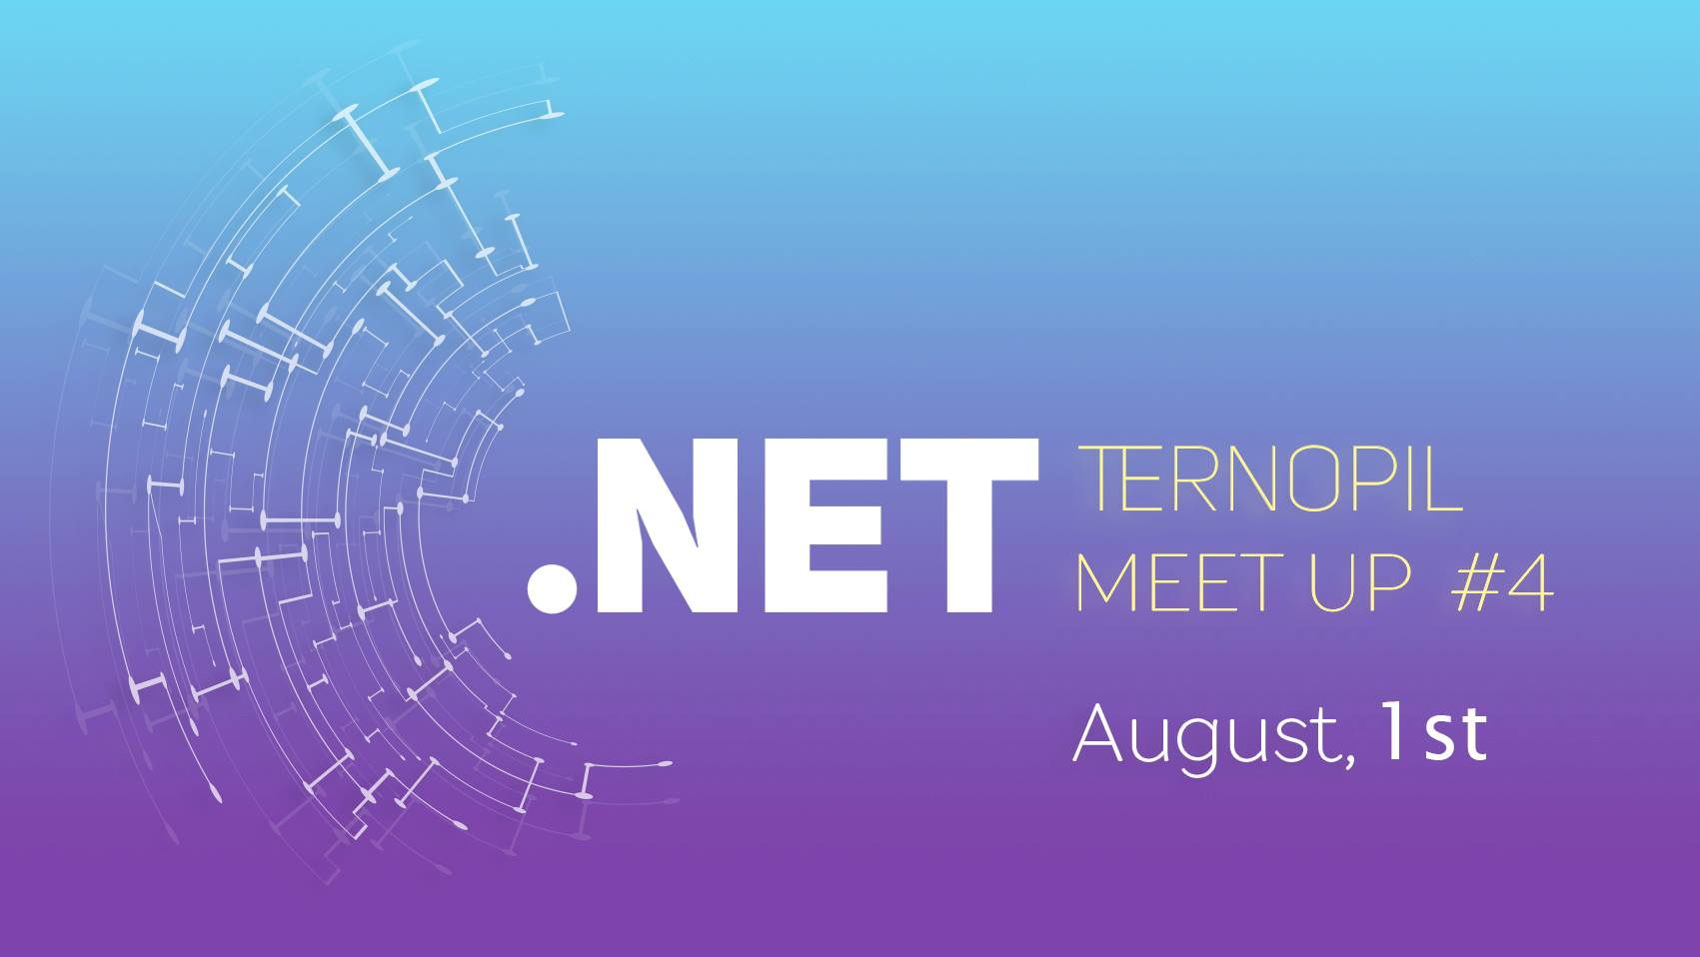
Notes:
Hello everyone. I will be talking about Docker and why it is such a great tool. If some of you haven’t hear about it yet, it’s not a problem because I will get through some basics of Docker.
So…
I guess some of you said or heard somebody else say „Hmm… That’s strange! It works on my computer!”.
Well, this is the problem we face almost every day. Usually the person that caused and error in the code does not see it on his own PC. We will be talking about this issue and what should we do to prevent it.
!Make sure everyone hears you!
Source codes and presentation itself will be available online on my github account https://github.com/l-wiewiora/TernopilDotNet
!Make sure everyone hears you!

Slide 2
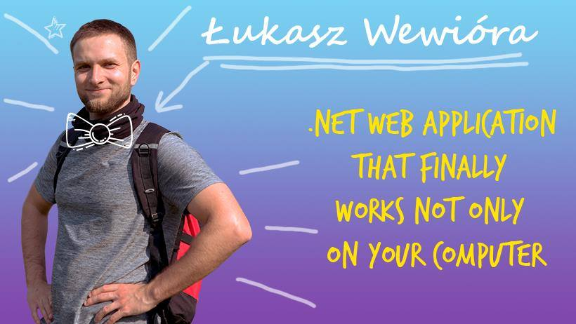
Notes:
Hello everyone. I will be talking about Docker and why it is such a great tool. If some of you haven’t hear about it yet, it’s not a problem because I will get through some basics of Docker.
So…
I guess some of you said or heard somebody else say „Hmm… That’s strange! It works on my computer!”.
Well, this is the problem we face almost every day. Usually the person that caused and error in the code does not see it on his own PC. We will be talking about this issue and what should we do to prevent it.
!Make sure everyone hears you!
Source codes and presentation itself will be available online on my github account https://github.com/l-wiewiora/TernopilDotNet
!Make sure everyone hears you!

Slide 3
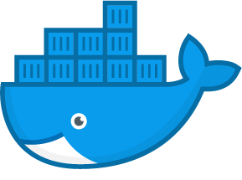


1 August 2018, Ternopil
Dockerized .NET web application that finally works not only on your computer
github.com/l-wiewiora
Notes:
Hello everyone. I will be talking about Docker and why it is such a great tool. If some of you haven’t hear about it before, it’s not a problem because I will get through some basics of Docker.
So…
I guess some of you said or heard somebody else say „Hmm… That’s strange! It works on my computer!”.
Well, this is the problem we face almost every day. Usually the person that caused and error in the code does not see it on his own PC. We will be talking about this issue and what should we do to prevent it.
!Make sure everyone hears you!
Source codes and presentation itself will be available online on my github account https://github.com/l-wiewiora/TernopilDotNet
!Make sure everyone hears you!

Slide 4
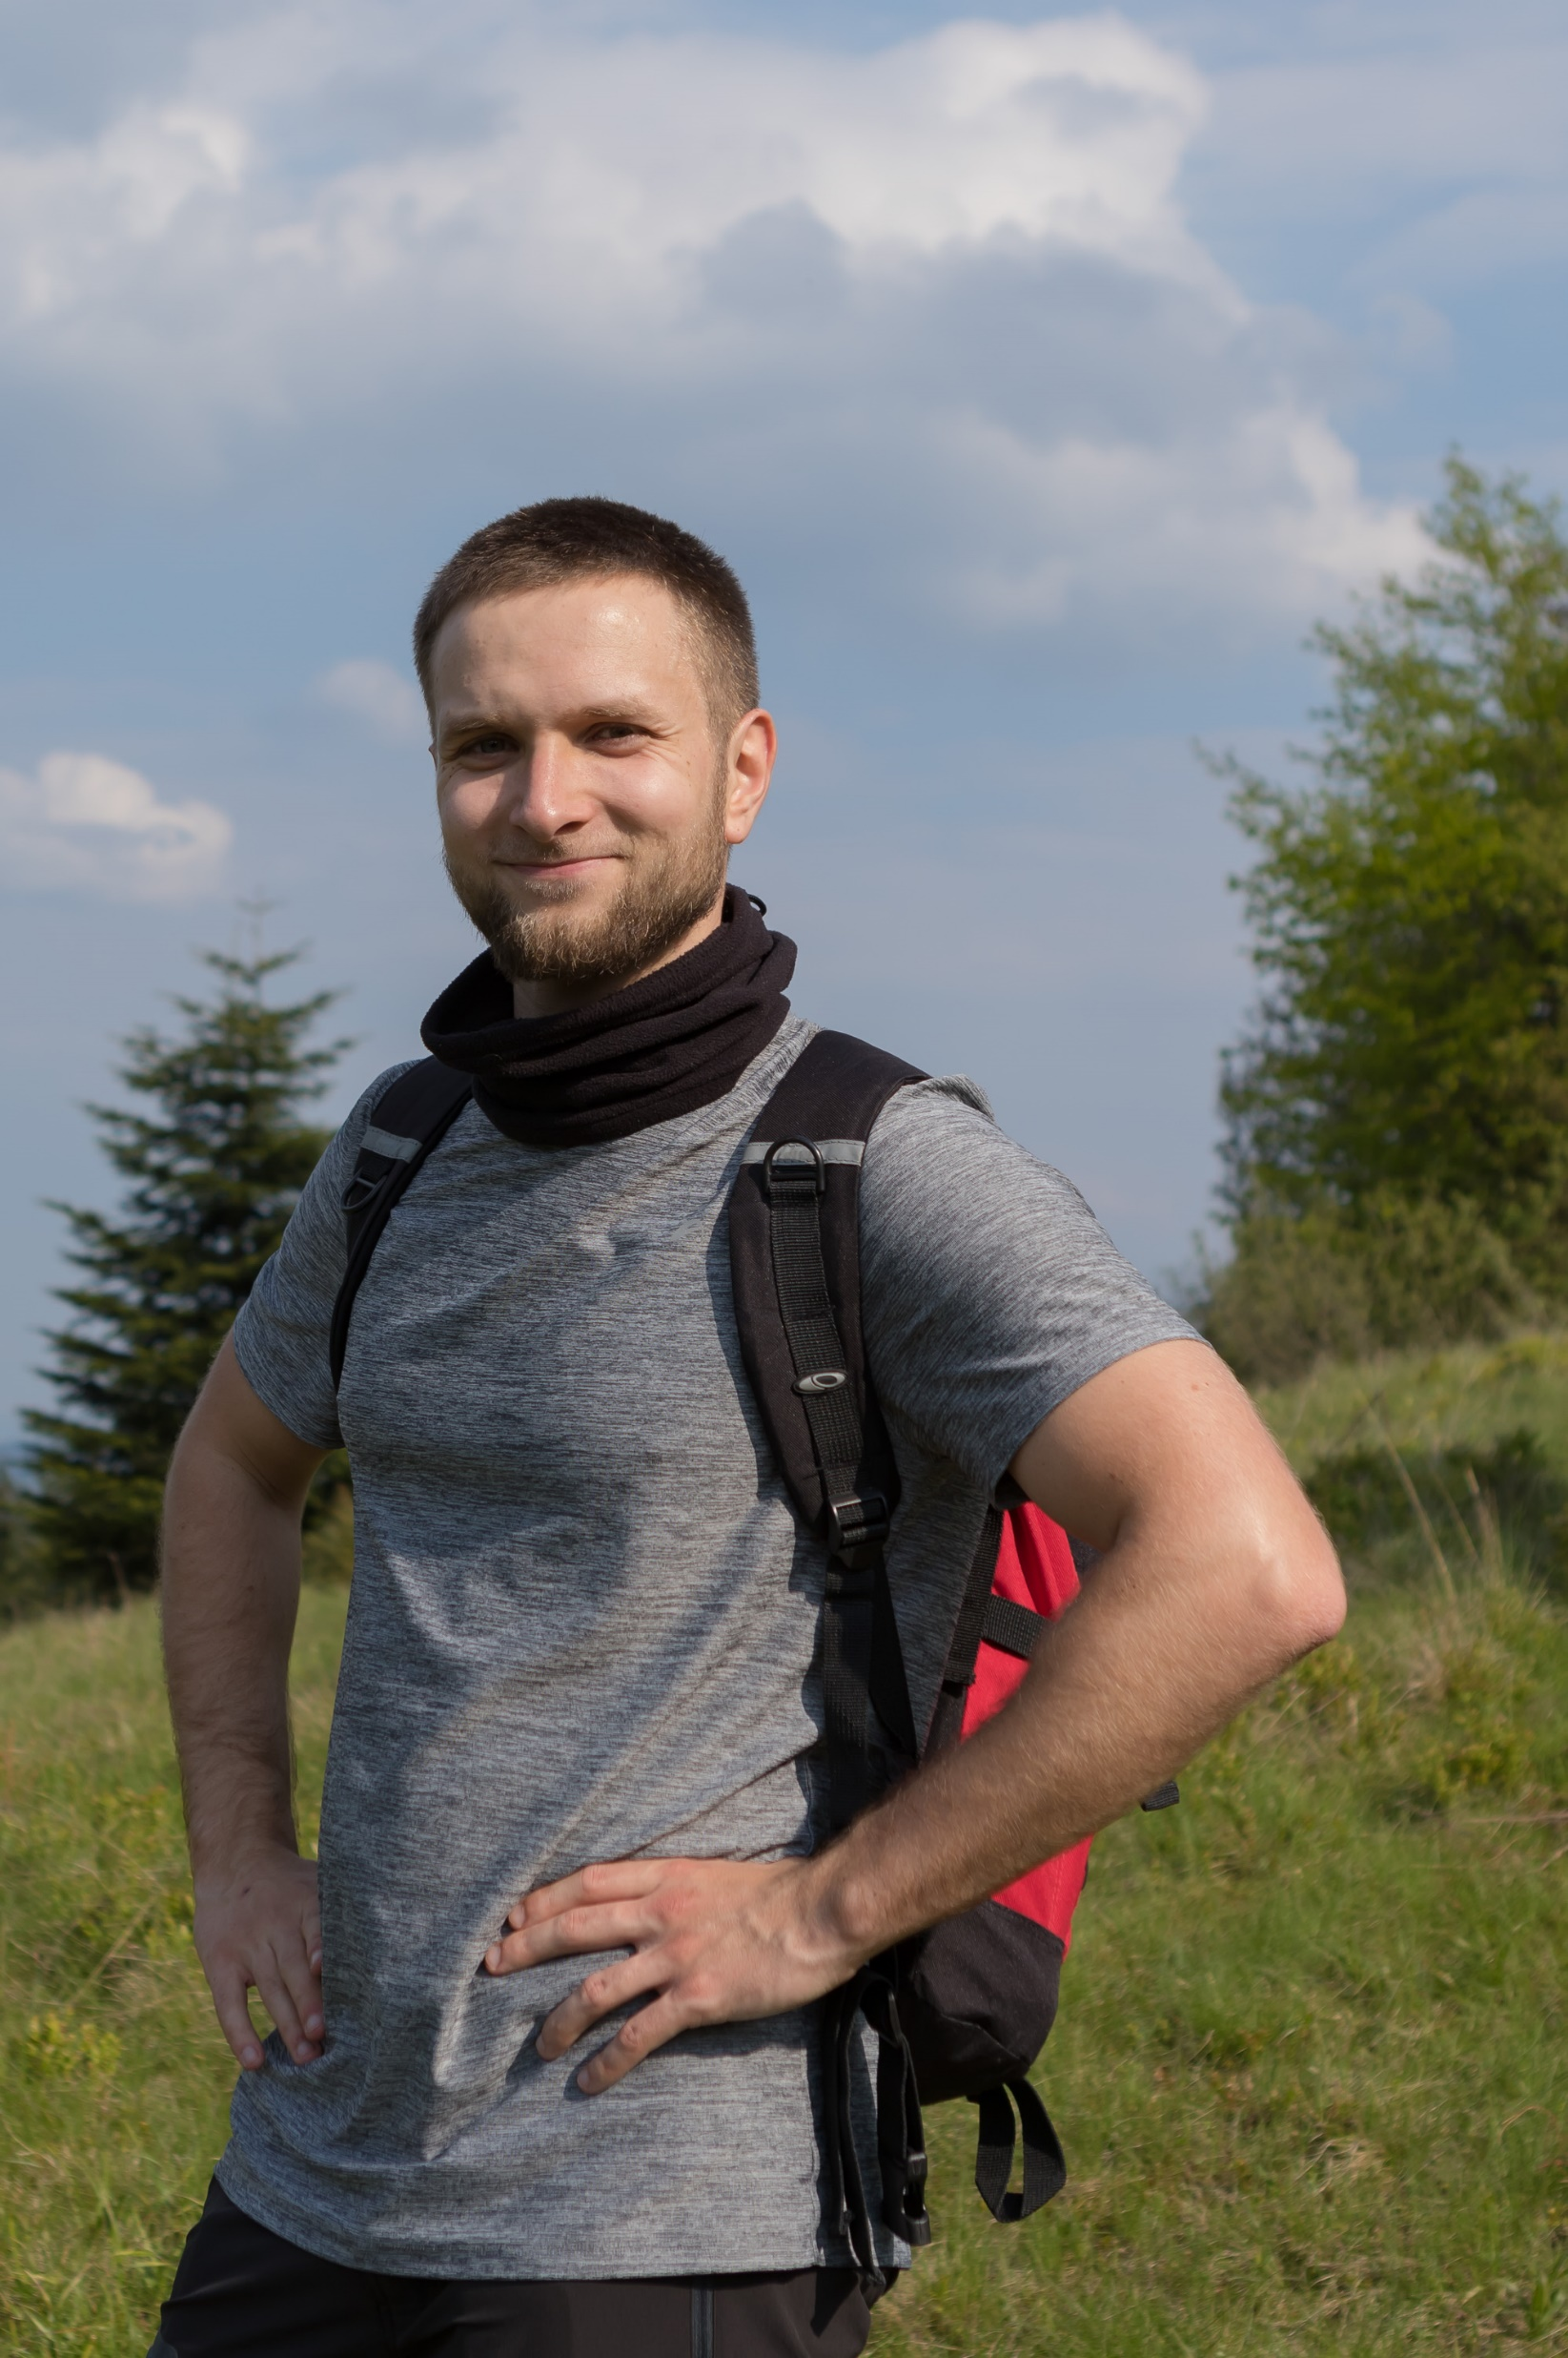
Before we start…
Software Developer in
4 years of experience in .Net
IT security enthusiast
Love hiking and mountains
Notes:
About me
I am ….
Software developer
Experience
I love hiking and sight seeing; whenever I can I try to stay away from town

Slide 5
What is ?
Notes:
Think about Docker like a really lightweight virtual machine. It creates separated environment for your applications.

Slide 6
What is Docker?
Docker is an open platform for developing, deploying, and running applications.
Docker enables you to separate your applications from your infrastructure so you can deliver software quickly.
Docker provides the ability to run an application in a loosely isolated environment called a container.
Docker packages application and their dependencies together into an isolated environment, making it platform independent. It eliminates the „works on my machine” problem once and for all.
Notes:
Docker is an open platform for developing, deploying, and running applications.
Docker enables you to separate your applications from your infrastructure.
Docker provides the ability to run an application in a loosely isolated environment called a container.
Docker basically packages application and their dependencies together into an isolated environment, making it platform independent. It eliminates the „works on my machine” problem once and for all.

Slide 7



Virtual machine VS Container
Hypervisor-based Virtualization
Container-based Virtualization
}
App 1
App 2
App 3
Virtual
Machines
Bins/Libs
Bins/Libs
Bins/Libs
Guest OS
Guest OS
Guest OS
{
App 1
App 2
App 3
Containers
Bins/Libs
Bins/Libs
Bins/Libs
Hypervisor
Container Engine
Host OS
Host OS
Infrastructure
Infrastructure
Notes:
Virtualization
VM runs full operating system
Each VM has it’s own copy of OS and each of OS usually consumes from 10GB to 30GB of disc space
VMs provide an environment with more resources than most applications need.
Docker
Docker Containers use Kernel of the Host Operating System
Each of the Containers does not need full copy of Operating System because some of the functionalities are borrowed from Host Operating System
Shared Kernel is called Container Engine
Docker Containers are much more cost effective because you don’t need to run or build entire operating system
Containers consume less CPU, RAM, storage space then VMs,
It’s much faster to start new Docker container then to start new VM

Slide 8
Why docker?
Platform/environment independent
Application scalability
Small containers – quick to start
Shorter downtime
Docker is lightweight and fast. It provides a viable, cost-effective alternative to hypervisor-based virtual machines
Notes:
Why docker is good choice?
It’s not dependent on platform we are developing or running it.
It’s perfect choice if we want to scale your application and run it on multiple servers.
Containers are small and they start quickly so for instance if our app crashes we can restore it quicker. If you need to release update of your software then again you can ensure shorter downtime
Smallest docker container for hosting .Net core application could have about 300mb,
where usually for VM it’s few GB because we have to run whole operating system on it.

Slide 9
Docker keywords
Docker file
Docker image
Docker container
Notes:
Let’s talk about what Docker really is.
During this presentation I will be mentioning these 3 Docker keywords.
It’s very important to understand what these 3 things are.

Slide 10
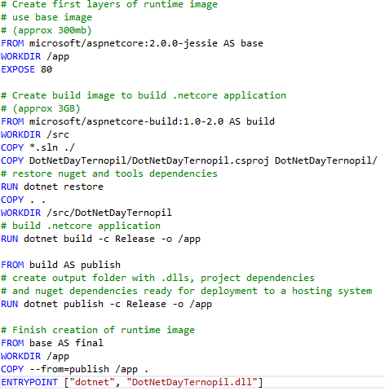
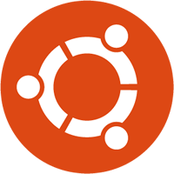
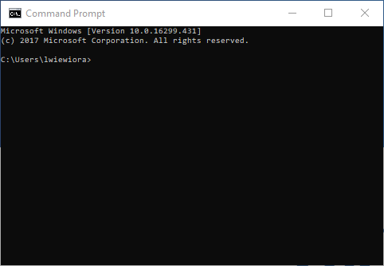
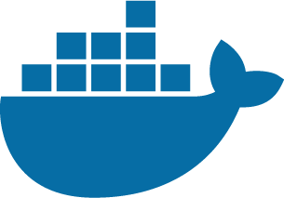
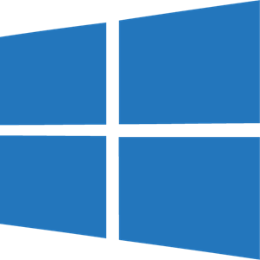
Docker key words
Docker file
List of instructions for building docker image
Docker image
Template for creating a Docker container
Docker container
Runnable instance of an image
Notes:
From the bigger picture.
We use Dockerfile to descibe our docker image; what should be in that image(apps, libs tools), what should happens when is starts. So Dockerfile is just a list of instructions for building docker image.
I can for instance specify in Dockerfile that I would like my ubuntu image to have let’s say python and mysql database available from the start.
Docker image is really an executable package that contains everything needed to run our application. This is basically a template for creating a Docker Container.
Usually you would have one Docker image that is running on multiple containers maybe on separate servers.
The container is a runtime instance of an image

Slide 11
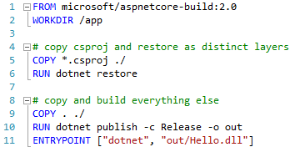
Dockerfile Recipe for Docker image
Every line is a new intermediate image
Container is rebuild only starting from place where change happened
Images are build using base images
Notes:
Let’s discuss Dockerfile a little bit more
-On the right you can see Dockerfile for .net application
-I will not get into every aspect of what is written there, but you what you should know:
-we start building images using a base image which is usually as lighweight and as simple as possible for our case; in the example above it’s microfo…build which is really Ubuntu with DotnetCore
-on top of that base image we add dependencies, install libraries or execute command line instructions to configure our environment
-what’s more… every line is a new intermediate image that is used as cache when we rebuild our images;
-if for instance we change our .csproj file then the image will be rebuild starting from line 5 one the screen. All the previous steps will be taken from cache. So the image will be rebuild starting from the point where change occured;
-This is great thing when we are developing our application and a lot of things are changing.

Slide 12
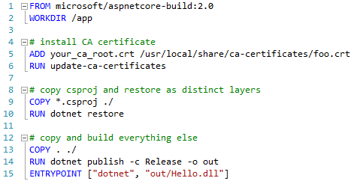
Dockerfile Recipe for Docker image
What if we would like to have certificate in our docker image?
Notes:
OK, let’s say we need certificate to validate something in our application. This could be a token or remote server.
We can add certificate to our docker image with this two example instructions.
What’s worth to say is certificate will only exist inside docker container. The host machine will not have that certificate in it’s store.

Slide 13
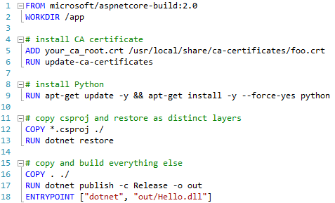
Dockerfile Recipe for Docker image
What if we would like to have Python in the image as well?
Notes:
OK, but what if we also need python in our development environment. Imagine we need to run python script to do some image recognition…
Then again we can add this one instruction to our Dockerfile
So as you can see…
We create image put our files there and wait for things to happen, wait for application to build
What is funny there, we don’t even need dotnet or visual studio on host machine. Docker has dotnet it in it’s base image in the first line. I could now remove VS and switch do notepad to edit files in solution and everything will work as good as before.
What’s more… if application fails to build there (inside docker) it’s not going to build anywhere, if it succeeds to build there it will run on any computer running Docker

Slide 14
Consider the following example scenario:
New developer/tester joins the team
His first task is to configure his working environment along with testing environment to execute tests and debug application
It’s at least day or two for each new developer to configure his PC, install all necessary dependencies just to start coding or testing
Notes:
Consider the following example scenario:
New developer/tester joins the team
His first task is to configure his working environment along with testing environment to execute tests and debug application
It’s at least day or two for each new developer to configure his PC, install all necessary dependencies just to start coding or testing
It’s a huge waste of time and resources. We can avoid it if we use Docker to setup our development environment

Slide 15
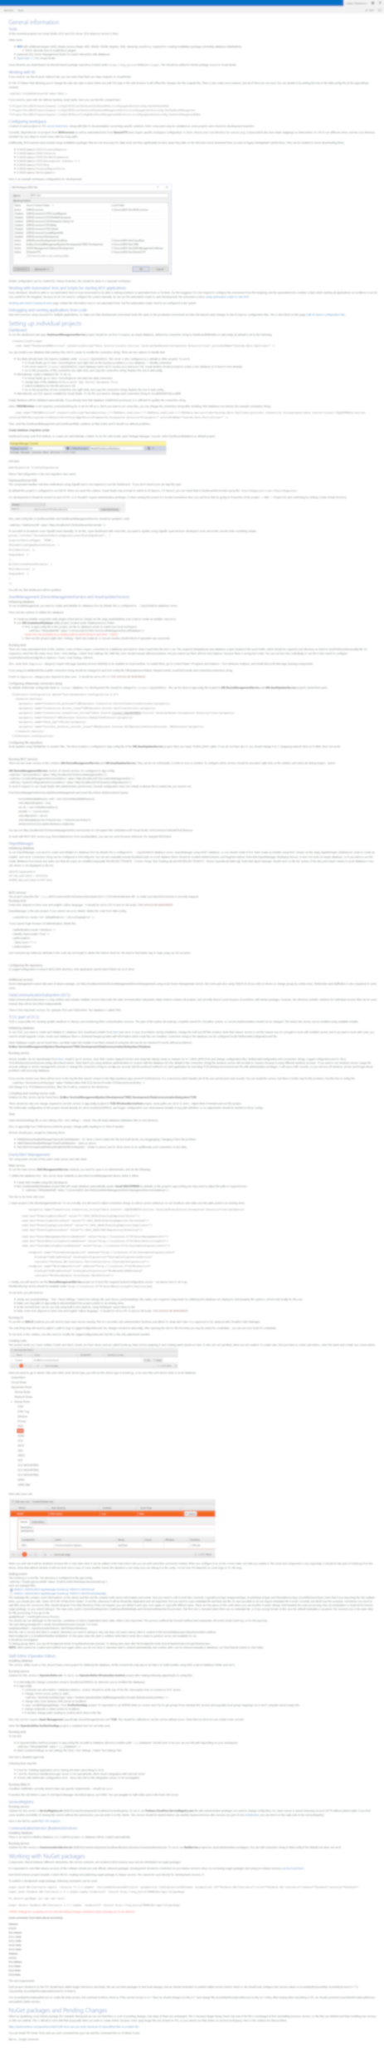
Consider the following example scenario:
New developer/tester joins the team
His first task is to configure his working environment along with testing environment to execute tests and debug application
It’s at least day or two for each new developer to configure his PC, install all necessary dependencies just to start coding or testing
Notes:
I remember one project I was working on where our documentation page for setting up environment had lines and lines of instructions. It took me at least two days to configure everything and even that was not enough; I had to work with some of the functionality missing because it was to hard to configure it and I was too flustrated and wanted to do something productive.

Slide 16
Consider the following scenario:
Developer writes code locally and share his work with colleagues.
Developer forgets to notify his team about new dependency (certificate, database, folder, hosts file) that should be installed on devs PCs.
Whole team is struggling to run the project wasting time to find why things stopped working, where person responsible for that doesn’t see side effects.
Notes:
Consider the following scenario:
Developer writes code locally and share his work with colleagues.
Developer forgets to notify his team about new dependency.
That could be a certificate, new database version, hosts file modification etc.
Then the whole team is struggling to run the project wasting time to find why things stopped working, and how to fix it, where person responsible for that doesn’t see any side effects and everything works fine.

Slide 17
Consider the following scenario:
Developer writes code locally and share his work with colleagues.
Developer forgets to notify his team about new dependency (certificate, database, folder, hosts file) that should be installed on devs PCs.
Whole team is struggling to run the project wasting time to find why things stopped working, where person responsible for that doesn’t see side effects.
DEMO
Notes:
Well… I will present short demo for this scenario.

Slide 18
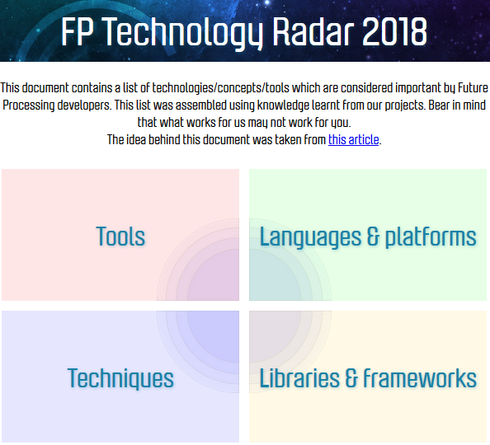
Technology Radar available at:
https://techradar.future-processing.com
Notes:
Every year in Future Processing we are doing a small survey, asking our engineers what technologies, tools, libraries or techniques do they recommend and which they don’t.
We do this to share knowledge, which things should we adapt in our project and which should we avoid. Believe me there is nothing worse than choosing wrong technology stack for new project.

Slide 19
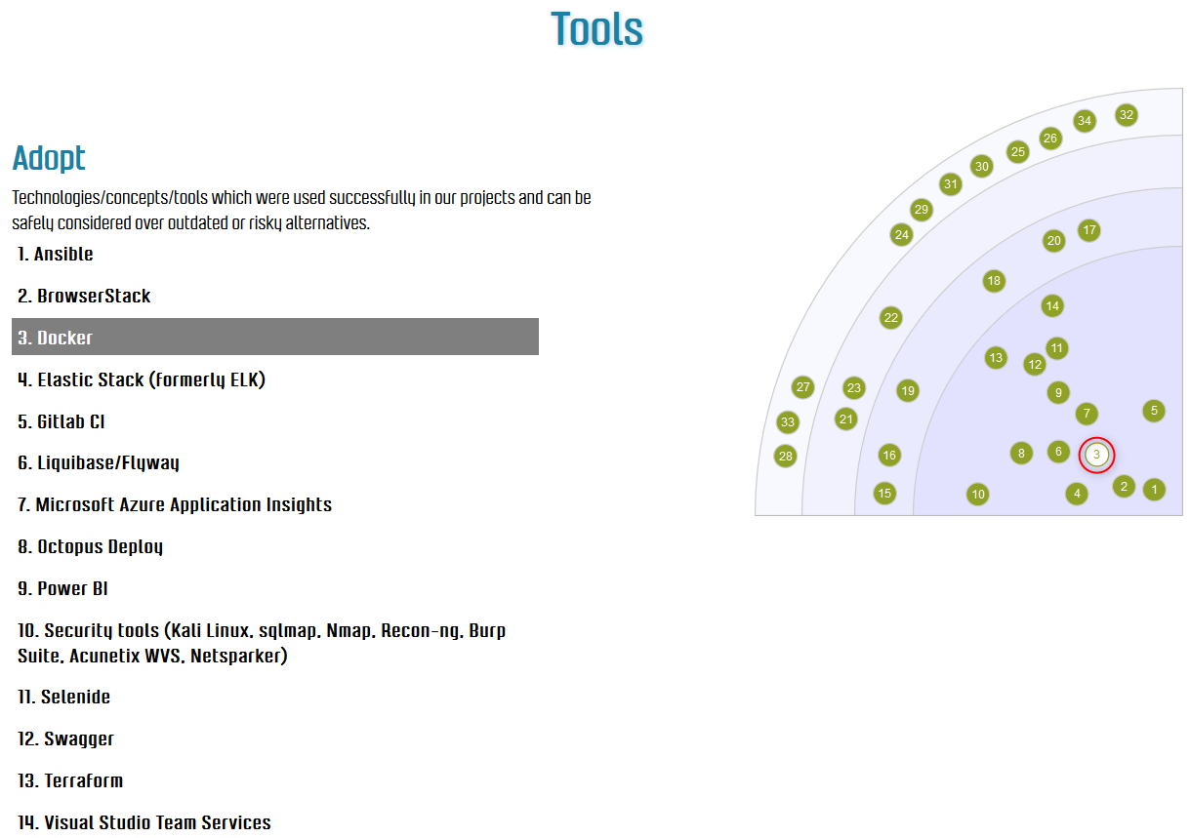
https://techradar.future-processing.com
Notes:
And Docker was considered top 3 of the most recommended tools. Many people use it in their work projects with success, many tried it for their home projects with success. I am pretty sure next year it will still be at the top.
If you are more interested in technologies we use and recommend or… not recommend then visit link on the presentation for more detailed information.
Result of this survey are available online for everyone. Address is on the screen.

Slide 20
Thank you
1 August 2018, Ternopil
github.com/l-wiewiora
Notes:
Thank you
Source codes and presentation itself will be available online on my github account.

